Slide 1
Correlation of 2014-2018 Internal US Migration Patterns to Local Cost of Living
Data Analytics Online Boot Camp – September 2020
Group 6
Adam Womer
Dillon Hanel
Valeria Sgambati
Bob Thomson

Slide 2
Project Overview
For many years, news stories have cited the general trend of migration from high cost of living regions to lower cost of living regions
“10 reasons why so many people are moving to Texas” – BBC News, May 2013
(1) Jobs, (2) It’s cheaper, (3) Homes, (4) Low Tax, …
“An old Wall Street money manager with $500 billion is moving to Nashville from Manhattan to save money” – CNBC, May 2018
AllianceBerstein CEO Seth Bernstein noted lower living expenses, taxes and housing costs for employees
Our project focused on testing these anecdotal observations against detailed public data available from the Federal government
Due to the substantial differences in the cost of living within states, we focused our analysis on county-level data
Our hypothesis is that differences in local cost of living is strongly correlated to county-level migration patterns

Slide 3
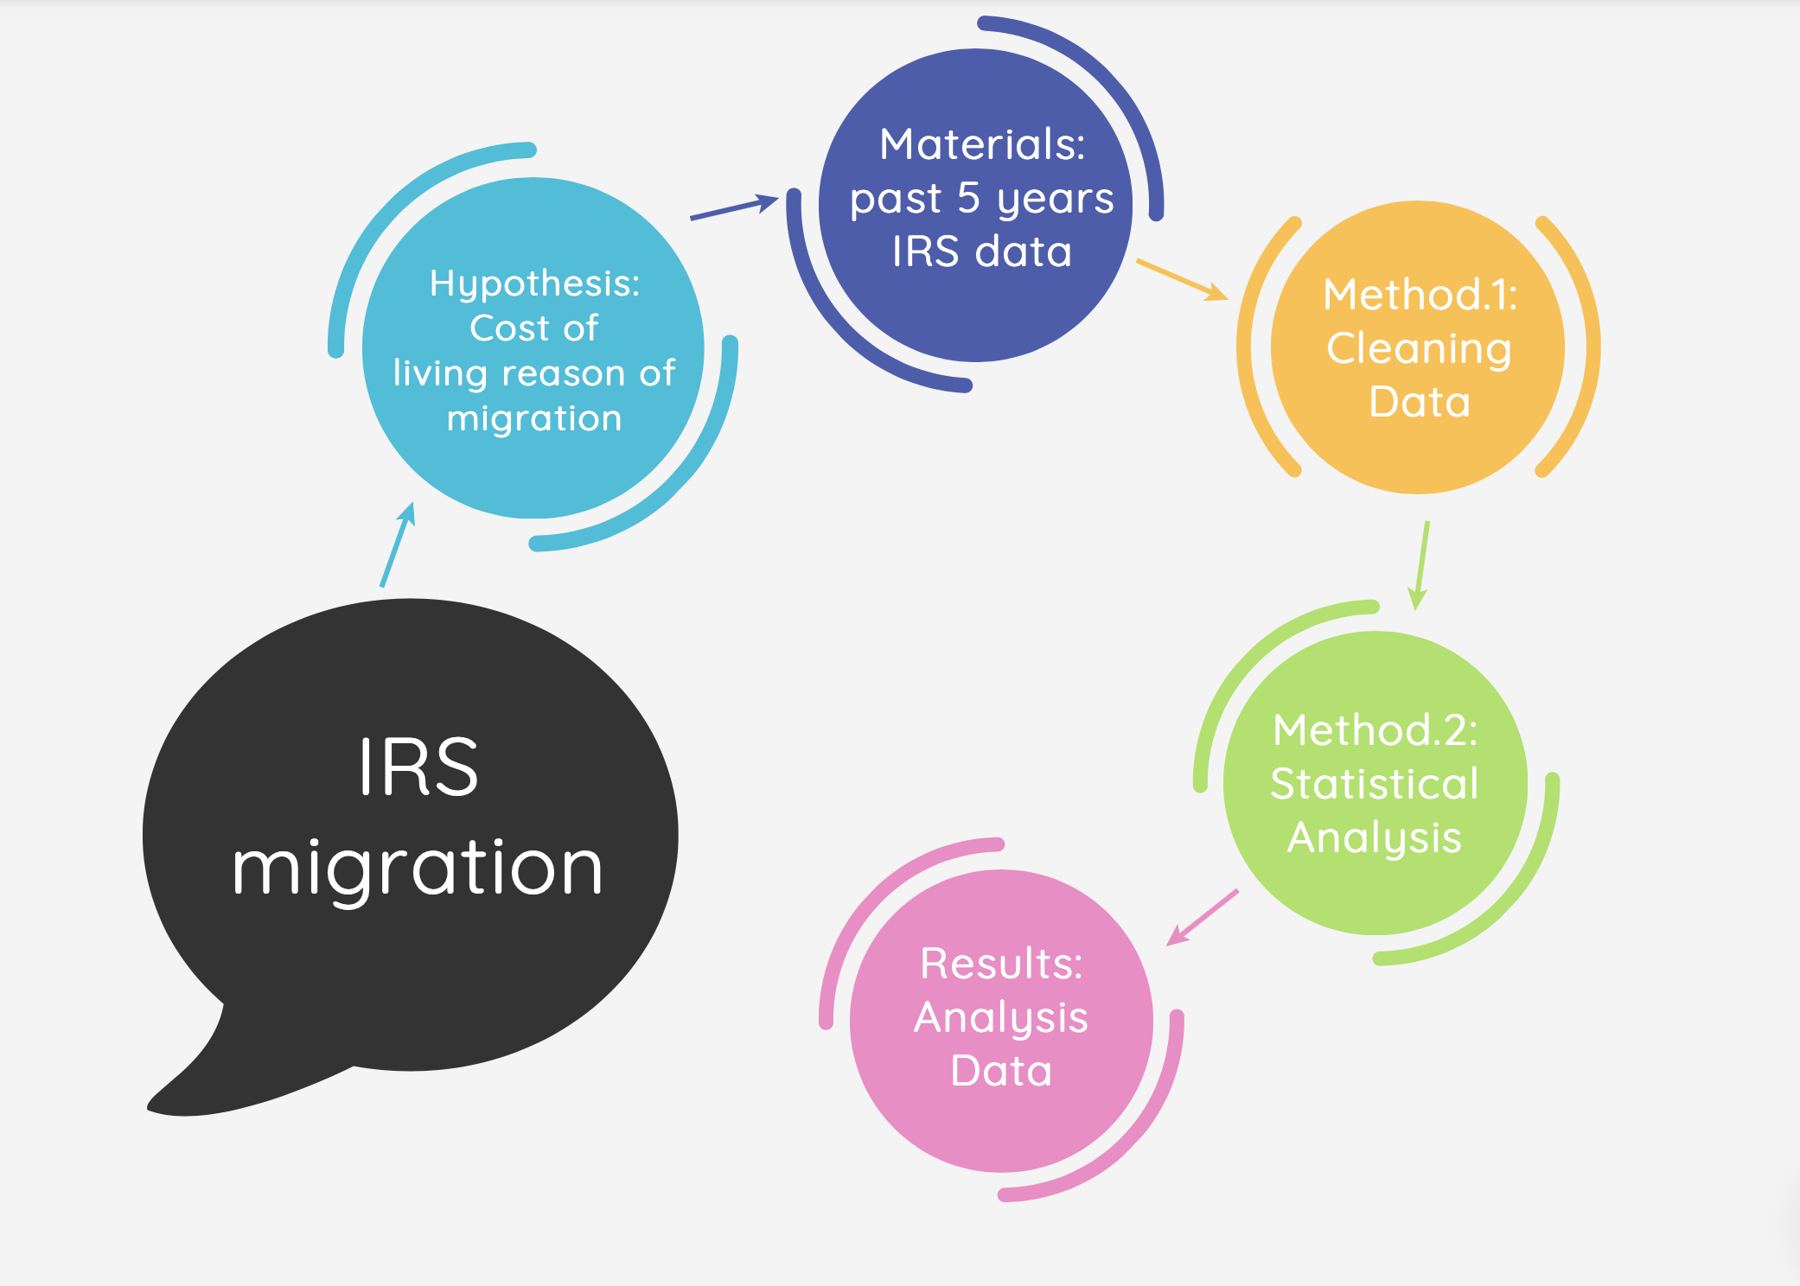
Project Flow

Slide 4
Data Sources
Migration patterns obtained from the U.S. Census Bureau
County-level data only available for five-year cumulative periods
Cost parameters derived from IRS data
Cumulative data based on tax returns published for each tax year based on zip code
Consolidation of data for tax years 2014 through 2018 necessary to provide an appropriate basis of comparison to the five-year cumulative migration data
Additional public information required to finalize database
“unitedstateszipcodes.org” provided county location for each zip code
County longitude and latitude available through Wikipedia

Slide 5
Data Analysis
Data extraction and transformation performed using Python
Migration data contained 573 fields for over 70 thousand records
IRS data consisted of 153 fields for over 27 thousand records
Linear regression model developed to test hypothesis
Refinements will be based on outcome of initial model
Linear regression metrics will be outlined and reviewed
Focus on r-squared for overall fit and slope associated with cost of living as test of hypothesis
Color-coded maps showing
Net migration into (out of) counties
Local costs

Slide 6
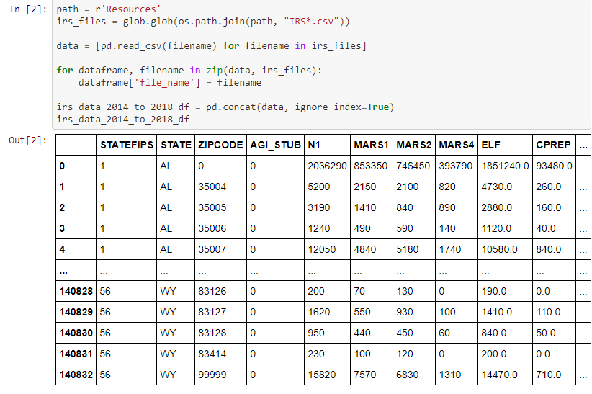
Methodology
Data extraction and transformation performed using Python
(DH)

Slide 7
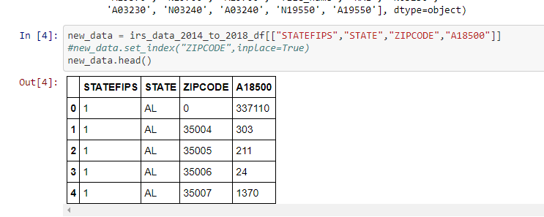
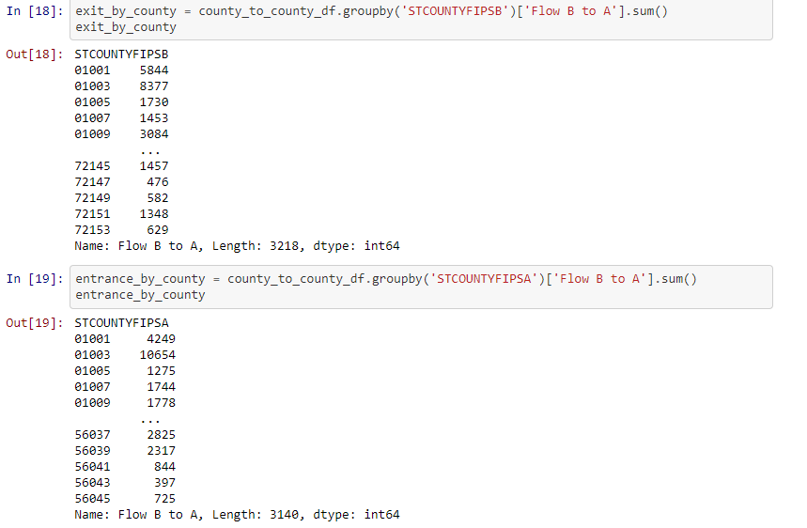
Methodology
Real Estate Taxes
Migration Flows

Slide 8
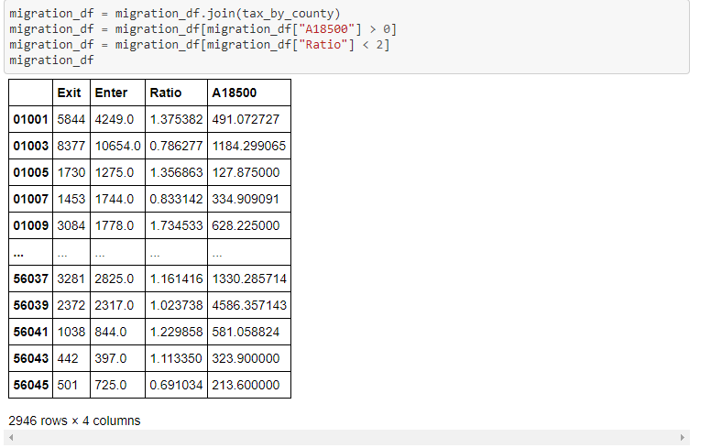
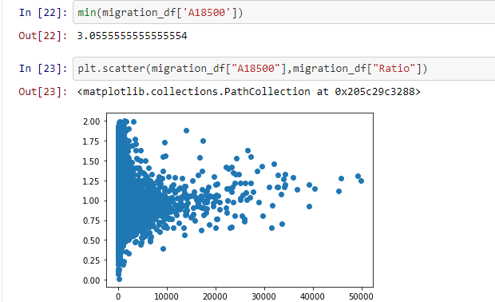
Ratio, Data, and Chart

Slide 9
Results
https://public.tableau.com/profile/adam.womer#!/vizhome/MigrationVisualization_16162707219580/Dashboard1?publish=yes

Slide 10
Summary
Results do not support the commonly held belief that migration during the 2014-2018 timeframe was influenced by cost of living
Additional work on this time period should focus on other potential factors e.g. job growth and political climate
Analysis of migration flows during the COVID-19 pandemic timeframe (March 2020 to ??) may need to focus on entirely different factors, notably population density

